Slide 1

Evaluating the Impact of Training Dataset Bias on Facial Detection Software
By Julia Grace Medina

Slide 2
Introduction

Slide 3
Facial Recognition
The FBI and more than 25% of state and local police departments use facial recognition software [1]
26-30 states use facial recognition software on databases which include drivers license and ID photos [1]
More than 117 million people are included in law enforcement facial recognition databases [1]
Private companies create facial recognition software and sell or license it to law enforcement agencies [1]
There is little oversight of this process [1]

Slide 4
How Well Does Facial Recognition Work?
Research has found that facial recognition software performs more accurately on White people than it does on Black people [2]
It also performs more accurately on men rather than women [2]
Image recognition softwares have been shown to perform more accurately on testing datasets similar to the training datasets [3]
Widely available facial recognition datasets are largely white [4]
The Face Recognition Grand Challenge Dataset was 70% Caucasian [4]

Slide 5
Hypothesis
If the training dataset is the source of the disparities with which facial recognition software identifies people of different races than a facial detection software trained on a racially balanced training dataset will show less variation in accuracy based on the race of subjects in testing images than a facial detection software trained on biased datasets.

Slide 6
Methodology

Slide 7
Methodology
Training Datasets
Dataset A- an unbiased dataset with 50% White and 50% Black faces
Dataset B- a biased dataset with 75% Black faces and 25% White faces
Dataset C- a biased dataset with 75% White faces and 25% Black faces
Negative Dataset- No faces
Haar Cascades
Cascade Trainer GUI Version 3.3.1
Python Facial Detection Script
Created to draw a rectangle around any faces detected using an xml cascade file

Slide 8
Results

Slide 9
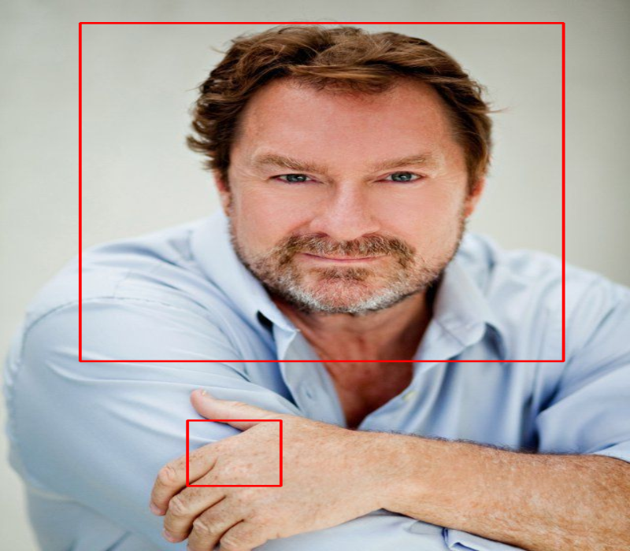

Sample Results

Slide 10
Dataset A
Dataset B
Dataset C

Slide 12
Discussion

Slide 13
Discussion
Mixed results
The software trained on the unbiased dataset showed biased results
However the softwares trained on the biased datasets each were more accurate identifying faces of the race which made up the majority of the dataset.
Obstacles
Image availability impacted dataset creation
Conclusion
Further study is needed into how dataset bias impacts facial detection and facial recognition software

Slide 14
References
[1]
“The Perpetual Line-Up,” Perpetual Line Up. [Online]. Available: https://www.perpetuallineup.org/. [Accessed: 28-Feb-2020].
[2]
B. F. Klare, M. J. Burge, J. C. Klontz, R. W. Vorder Bruegge, and A. K. Jain, “Face Recognition Performance: Role of Demographic Information,” IEEE Trans.Inform.Forensic Secur., vol. 7, no. 6, pp. 1789–1801, Dec. 2012, doi: 10.1109/TIFS.2012.2214212.
[3]
A. Torralba and A. A. Efros, “Efros. Unbiased look at dataset bias,” in In Proc. CVPR, pp. 1521–1528.
[4]
P. J. Phillips, F. Jiang, A. Narvekar, J. Ayyad, and A. J. O’Toole, “An other-race effect for face recognition algorithms,” ACM Trans. Appl. Percept., vol. 8, no. 2, pp. 14:1–14:11, Feb. 2011, doi: 10.1145/1870076.1870082.
[5]
A. Kortylewski, B. Egger, A. Schneider, T. Gerig, A. Morel-Forster, and T. Vetter, “Empirically Analyzing the Effect of Dataset Biases on Deep Face Recognition Systems,” in 2018 IEEE/CVF Conference on Computer Vision and Pattern Recognition Workshops (CVPRW), Salt Lake City, UT, USA, 2018, pp. 2174–217409, doi: 10.1109/CVPRW.2018.00283.

